Slide 1
Business Performance Dashboard

Slide 2
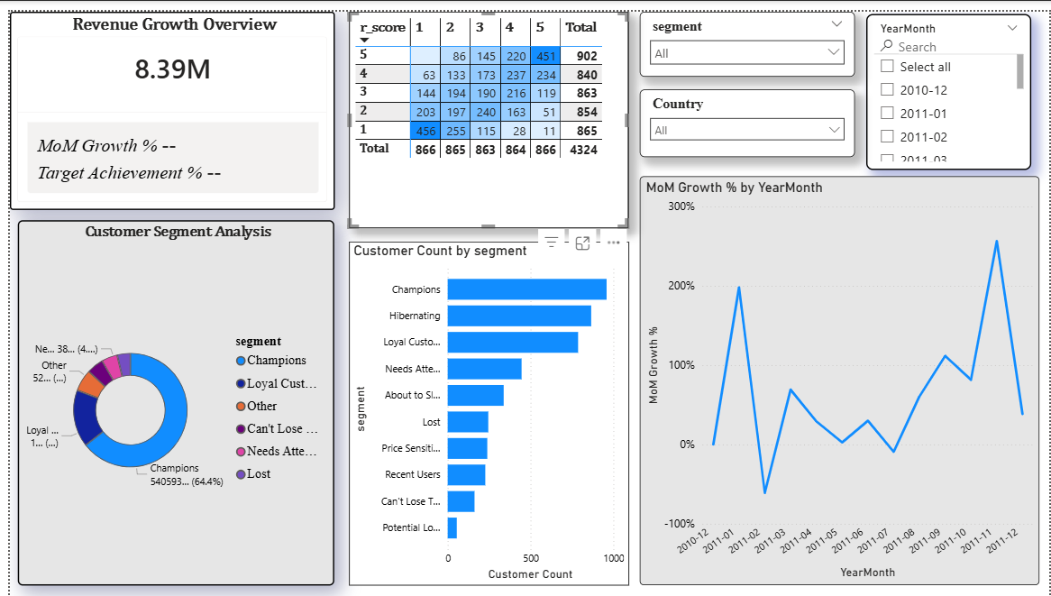
Dashboard Overview
Track revenue ,customer behaviour, monthly growth
Contains KPI cards, RFM matrix, Donut chart, Customer count, Mom Growth trend

Slide 3
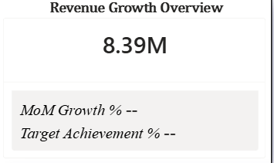
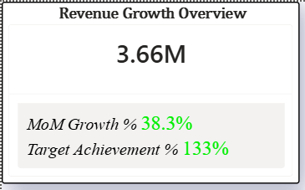
Current State ( No Month Selected)
Overall Revenue for all months
No reference Month
Blank for MOM Growth % and Target Achievement %
After Month Selection
Updates to selected Month Revenue
Calculated MoM Growth % of the selected Month
Calculated % of the target for the selected month

Slide 4
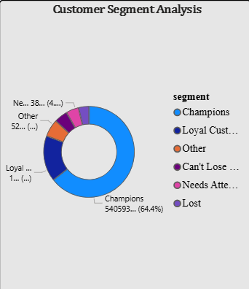
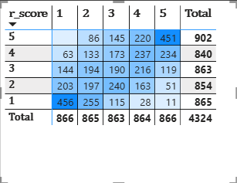
Champions and loyal customers contribute most revenue
At-Risk/Need Attention segments need attention

Slide 5
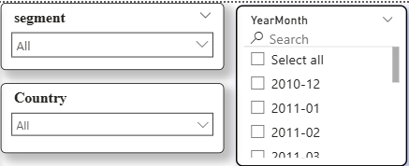
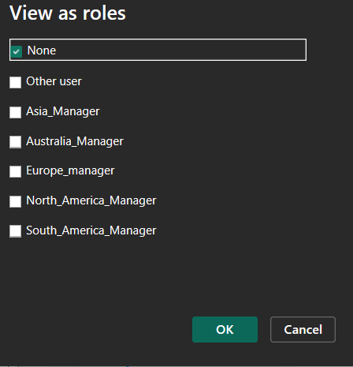
Filters & Interactive
Filters :
Segment, Country, Year-Month

Slide 6
Conclusion
Dashboard provide clear view of revenue , customer behaviour, growth trends
KPI cards give quick insights
Interactive RFM matrix and segment-wise visuals identify top-performing and at-risk customer segments
Filters allow easy drill-down and analysis
Supports data-driven business decisions and help focus on high-value customers

